Slide 1

Bestwind
Otimização em Eólica Offshore

Slide 2




Nosso time:
Vinicius Cunha
Rodrigo França
Ken Aikawa
Matheus Diniz

Slide 3
Bestwind – Otimização em Eólica Offshore
Problemática
Soluções
01
03
Quais as dores e de quem?
Qual a proposta de valor?
Público-alvo
Modelo de receita
02
04
Qual o potencial do mercado?
Como ganhar com a solução proposta?

Slide 4
Problemática
Mudanças climáticas
A queima de combustíveis fósseis para produção de energia é uma das principais causas do aumento das emissões de gases de efeito estufa na atmosfera.
Sustentabilidade
As usinas termelétricas e outras instalações de geração de energia que dependem de combustíveis fósseis também são responsáveis pela liberação de poluentes nocivos no ar
Poluição do ar
A maioria das formas tradicionais de geração de energia depende de recursos naturais finitos, como carvão e petróleo.

Slide 5

Público-alvo
Governo
Planejamento de infraestrutura energética.
Contrutoras
Planejamento e gerenciamento de obras.
Operadoras
Planejamento e gerenciamento de operação.

Slide 6
Soluções
01
02
03
04
05
06
07
Análise preditiva | Otimização do layout | Monitoramento em tempo real | Gerenciamento de dados | Integração de sistemas | Análise de dados avançada | Previsão de demanda e mercado
Otimização em Eólica Offshore

Slide 7
Modelo de receita
01
03
Estudos técnicos
Contratos de assessoramento
02
04
Mérito
Consultoria

Slide 8

Bestwind
Obrigado
Otimização em Eólica Offshore

Slide 9
Renewable Energy Infographics
Planets | Mercury | Mars | Saturn | Jupiter
Description | It’s the closest planet to the Sun | Venus is the second planet from the Sun | Mars is actually a very cold place | Jupiter is the biggest planet of them all
Notes | Jupiter is the biggest planet of them all | Despite being red, Mars is very cold | Neptune is far away from Earth | Mercury is a very small planet

Slide 10
Renewable Energy Infographics
Mercury
Jupiter
It’s the closest planet to the Sun
Jupiter is the biggest planet of them all
Venus
Saturn
Venus is the second planet from the Sun
It’s composed of hydrogen and helium
Mars
Neptune
Mars is actually a very cold place
It’s the farthest planet from the Sun

Slide 11
Renewable Energy Infographics
Type A
Type B
Type C
Type D
Venus
Jupiter
Mars
Saturn
Venus is the second planet from the Sun
It’s the biggest planet in the Solar System
Despite being red, Mars is a cold place
Saturn is a gas giant and has several rings

Slide 12
Renewable Energy Infographics
Energy
Sunlight
Mercury is the closest planet to the Sun
Jupiter is the biggest planet of them all
Transfer
Solar panels
Venus is the second planet from the Sun
Saturn is composed of hydrogen and helium
Battery
Power generation
Mars is actually a very cold place
Neptune is the farthest planet from the Sun

Slide 13
Renewable Energy Infographics
Mercury
It’s the closest planet to the Sun and the smallest one in the Solar System
Mars
Despite being red, Mars is actually a cold place. It’s full of iron oxide dust
Venus
Venus has a beautiful name and is the second planet from the Sun

Slide 14
Renewable Energy Infographics
Sun
Waste C
Earth is the third planet from the Sun
Jupiter is the biggest planet of them all
Waste A
Waste D
Venus is the second planet from the Sun
Saturn is a gas giant and has several rings
Waste B
Biomass
Mars is actually a very cold place
Biomass
Pluto is now considered a dwarf planet

Slide 15
Renewable Energy Infographics
01
03
Venus
Jupiter
03
Venus is the second planet from the Sun
It’s the biggest planet in the Solar System
01
02
04
04
Saturn
Mars
02
Saturn is a gas giant and has several rings
Despite being red, Mars is a cold place

Slide 16
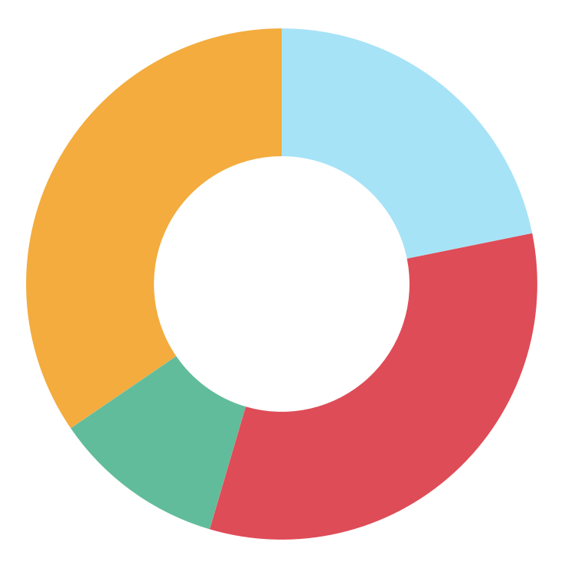
Renewable Energy Infographics
34,5%
21,8%
Venus
Jupiter
Venus is the second planet from the Sun
It’s the biggest planet in the Solar System
10,9%
32,7%
Mars
Saturn
Despite being red, Mars is a cold place
Saturn is a gas giant and has several rings
Follow the link in the graph to modify its data and then paste the new one here. For more info, click here

Slide 17
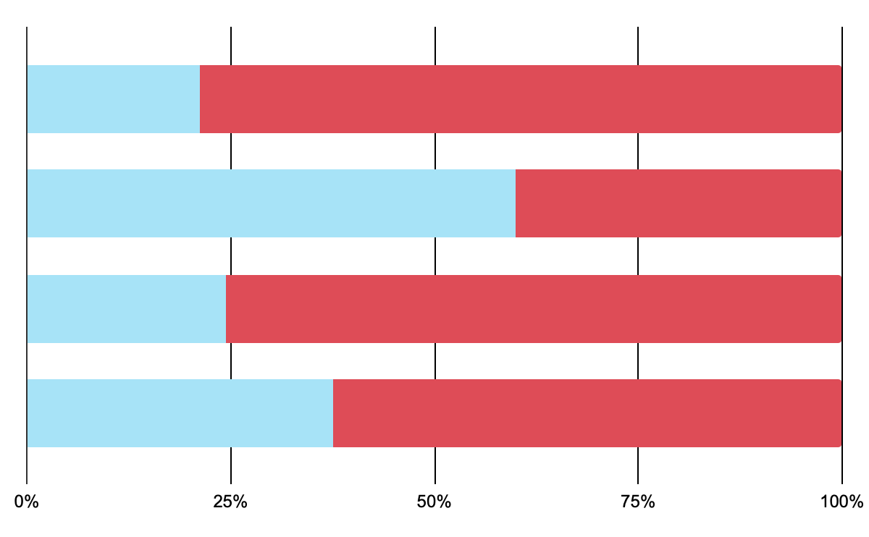
Renewable Energy Infographics
Period 1
Period 2
Venus
Jupiter
Venus
Venus is the second planet from the Sun
It’s the biggest planet in the Solar System
Jupiter
Mars
Saturn
Mars
Saturn
Saturn is a gas giant and has several rings
Despite being red, Mars is a cold place
Follow the link in the graph to modify its data and then paste the new one here. For more info, click here

Slide 18
Renewable Energy Infographics
01
02
03
04
05
06
07
Monday | Tuesday | Wednesday | Thursday | Friday | Saturday | Sunday
Earth is the third planet from the Sun | Venus is the second planet from the Sun | Mars is actually a very cold place | Jupiter is the biggest planet of them all | Saturn is a gas giant with several rings | Neptune is far away from Earth | Pluto is now considered a dwarf planet
Note 1 | Mercury is the closest planet to the Sun and the smallest one in the Solar System
Note 2 | Earth is the third planet from the Sun and the only one that harbors life in the Solar System

Slide 19
Renewable Energy Infographics
Mercury
01
It’s the closest planet to the Sun
01
Venus
02
Venus is the second planet from the Sun
05
02
Mars
03
Mars is actually a very cold place
Jupiter
04
04
03
Jupiter is the biggest planet of them all
Saturn
05
It’s composed of hydrogen and helium

Slide 20
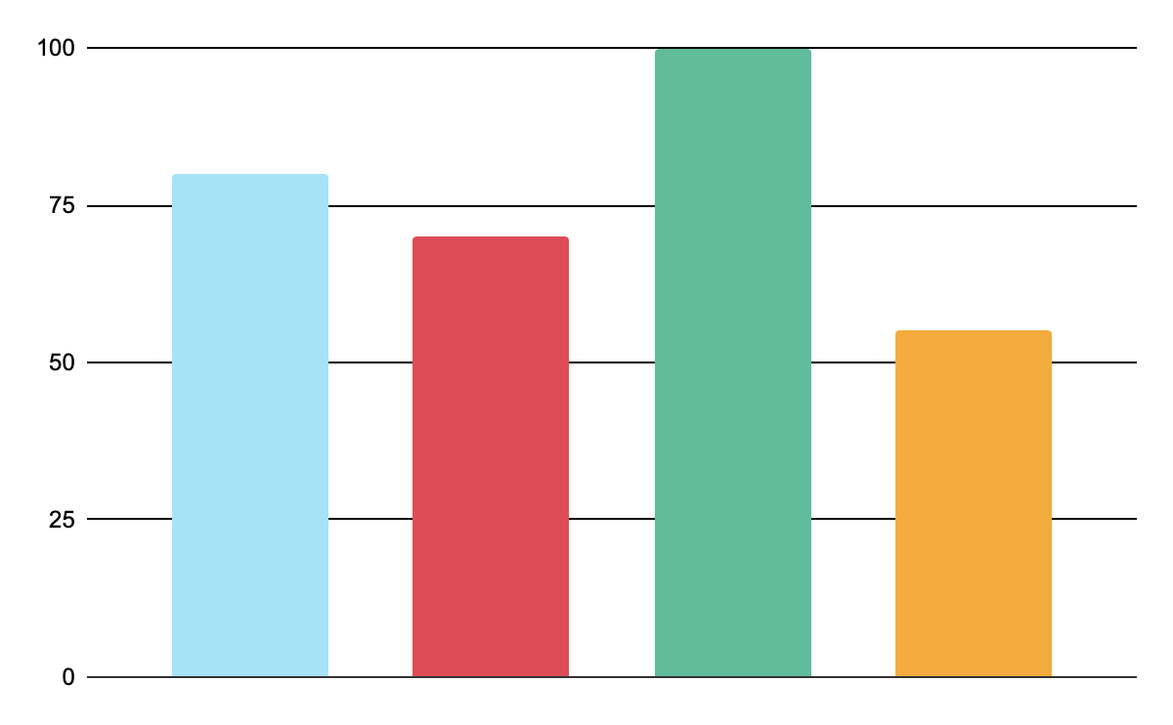
Renewable Energy Infographics
Venus
Jupiter
Venus is the second planet from the Sun
It’s the biggest planet in the Solar System
Saturn
Mars
Saturn is a gas giant and has several rings
Despite being red, Mars is a cold place
Follow the link in the graph to modify its data and then paste the new one here. For more info, click here

Slide 21
Renewable Energy Infographics
Saturn
Mars
03
04
It’s a gas giant and has several rings
Despite being red, Mars is a cold place
Mercury
Neptune
02
05
It’s the closest planet to the Sun
It’s the farthest planet from the Sun
Venus
Jupiter
01
06
Venus is the second planet from the Sun
It’s the biggest planet of them all

Slide 22
Renewable Energy Infographics
20%
40%
75%
Mercury
Venus
Mars
It’s the closest planet to the Sun and the smallest one in the Solar System
Venus has a beautiful name and is the second planet from the Sun
Despite being red, Mars is actually a cold place. It’s full of iron oxide dust

Slide 23
Renewable Energy Infographics
Mercury
Jupiter
01
04
It’s the closest planet to the Sun
Jupiter is the biggest planet of them all
Venus
Saturn
01
02
05
05
Venus is the second planet from the Sun
It’s composed of hydrogen and helium
02
03
Mars
Neptune
06
03
06
Mars is actually a very cold place
It’s the farthest planet from the Sun
04

Slide 24
Renewable Energy Infographics
Jupiter
Saturn
Neptune
Jupiter is the biggest planet of them all
It’s composed of hydrogen and helium
It’s the farthest planet from the Sun
Paper
95%
Plastic
50%
Glass
80%

Slide 25
Renewable Energy Infographics
Mercury
01
It’s the closest planet to the Sun and the smallest one in the Solar System
02
03
Venus
02
Venus has a beautiful name and is the second planet from the Sun
Mars
01
03
Despite being red, Mars is actually a cold place. It’s full of iron oxide dust

Slide 26
Renewable Energy Infographics
It’s the closest planet to the Sun
Venus is the second planet from the sun
Mars is actually a very cold place
Jupiter is a very big planet
It’s the farthest planet from the Sun
Jupiter is a very big planet
It’s considered a dwarf planet
Venus has a beautiful name

Slide 27
Renewable Energy Infographics
Mercury
It’s the closest planet to the Sun and the smallest one in the Solar System
Mars
Despite being red, Mars is actually a cold place. It’s full of iron oxide dust
Venus
Venus has a beautiful name and is the second planet from the Sun

Slide 28
Renewable Energy Infographics
South Africa
Latin America
South Asia
World migration
60%
Jupiter is the biggest planet of them all
Saturn is a gas giant and has several rings
Neptune is far away from Earth
Ceres is located in the main asteroid belt

Slide 29
Renewable Energy Infographics
Venus
01
02
Jupiter
01
03
Venus is the second planet from the Sun
It’s the biggest planet in the Solar System
Saturn
03
04
Mars
02
04
Saturn is a gas giant and has several rings
Despite being red, Mars is a cold place

Slide 30
Renewable Energy Infographics
Saturn
01
Saturn is a gas giant and has several rings
Venus
01
02
Venus is the second planet from the Sun
02
Jupiter
03
03
It’s the biggest planet in the Solar System

Slide 31
Renewable Energy Infographics
Venus
Venus is the second planet from the Sun
Jupiter
It’s the biggest planet in the Solar System
Saturn
Saturn is a gas giant and has several rings
Earth
Mars
Earth is the third planet from the Sun
Despite being red, Mars is a cold place

Slide 32
Renewable Energy Infographics
01
02
03
04
05
Venus
Jupiter
Saturn
Mars
Ceres
Venus is the second planet from the Sun
It’s the biggest planet in the Solar System
Saturn is a gas giant and has several rings
Despite being red, Mars is a cold place
Ceres is located in the main asteroid belt

Slide 33
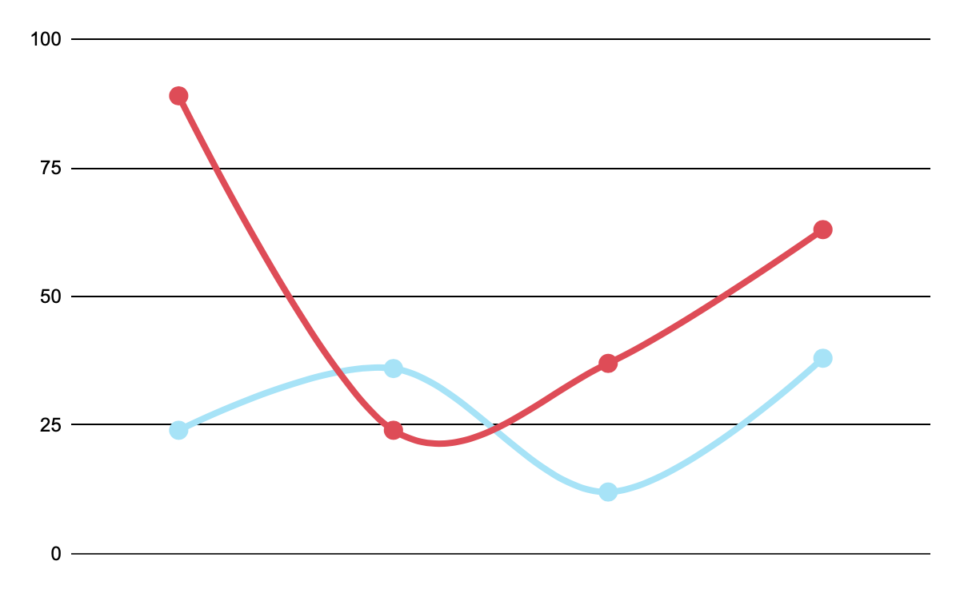
Renewable Energy Infographics
Mercury
Mercury is the closest planet to the Sun and the smallest one in the Solar System—it’s only a bit larger than the Moon
Venus
Venus has a beautiful name and is the second planet from the Sun. It’s hot and has a poisonous atmosphere
Jupiter
Saturn
Neptune
Pluto
Follow the link in the graph to modify its data and then paste the new one here. For more info, click here

Slide 34
Renewable Energy Infographics
Mercury
Jupiter
It’s the closest planet to the Sun
Jupiter is the biggest planet of them all
Venus
Saturn
Venus is the second planet from the Sun
It’s composed of hydrogen and helium
Mars
Neptune
Mars is actually a very cold place
It’s the farthest planet from the Sun

Slide 35
Instructions for use
In order to use this template, you must credit Slidesgo in your final presentation.
You are allowed to:
- Modify this template.
- Use it for both personal and commercial projects.
You are not allowed to:
- Sublicense, sell or rent any of Slidesgo Content (or a modified version of Slidesgo Content).
- Distribute Slidesgo Content unless it has been expressly authorized by Slidesgo.
- Include Slidesgo Content in an online or offline database or file.
- Offer Slidesgo templates (or modified versions of Slidesgo templates) for download.
- Acquire the copyright of Slidesgo Content.
For more information about editing slides, please read our FAQs or visit Slidesgo School:
https://slidesgo.com/faqs and https://slidesgo.com/slidesgo-school

Slide 36
Instructions for use (premium users)
As a Premium user, you can use this template without attributing Slidesgo or keeping the "Thanks" slide.
You are allowed to:
Modify this template.
Use it for both personal and commercial purposes.
Hide or delete the “Thanks” slide and the mention to Slidesgo in the credits.
Share this template in an editable format with people who are not part of your team.
You are not allowed to:
Sublicense, sell or rent this Slidesgo Template (or a modified version of this Slidesgo Template).
Distribute this Slidesgo Template (or a modified version of this Slidesgo Template) or include it in a database or in any other product or service that offers downloadable images, icons or presentations that may be subject to distribution or resale.
Use any of the elements that are part of this Slidesgo Template in an isolated and separated way from this Template.
Register any of the elements that are part of this template as a trademark or logo, or register it as a work in an intellectual property registry or similar.
For more information about editing slides, please read our FAQs or visit Slidesgo School:
https://slidesgo.com/faqs and https://slidesgo.com/slidesgo-school

Slide 37
Infographics
You can add and edit some infographics to your presentation to present your data in a visual way.
Choose your favourite infographic and insert it in your presentation using Ctrl C + Ctrl V or Cmd C + Cmd V in Mac.
Select one of the parts and ungroup it by right-clicking and choosing “Ungroup”.
Change the color by clicking on the paint bucket.
Then resize the element by clicking and dragging one of the square-shaped points of its bounding box (the cursor should look like a double-headed arrow). Remember to hold Shift while dragging to keep the proportions.
Group the elements again by selecting them, right-clicking and choosing “Group”.
Repeat the steps above with the other parts and when you’re done editing, copy the end result and paste it into your presentation.
Remember to choose the “Keep source formatting” option so that it keeps the design. For more info, please visit Slidesgo School.

